Slide 1
World of CSS Grid
By Shubham Sagar

Slide 2
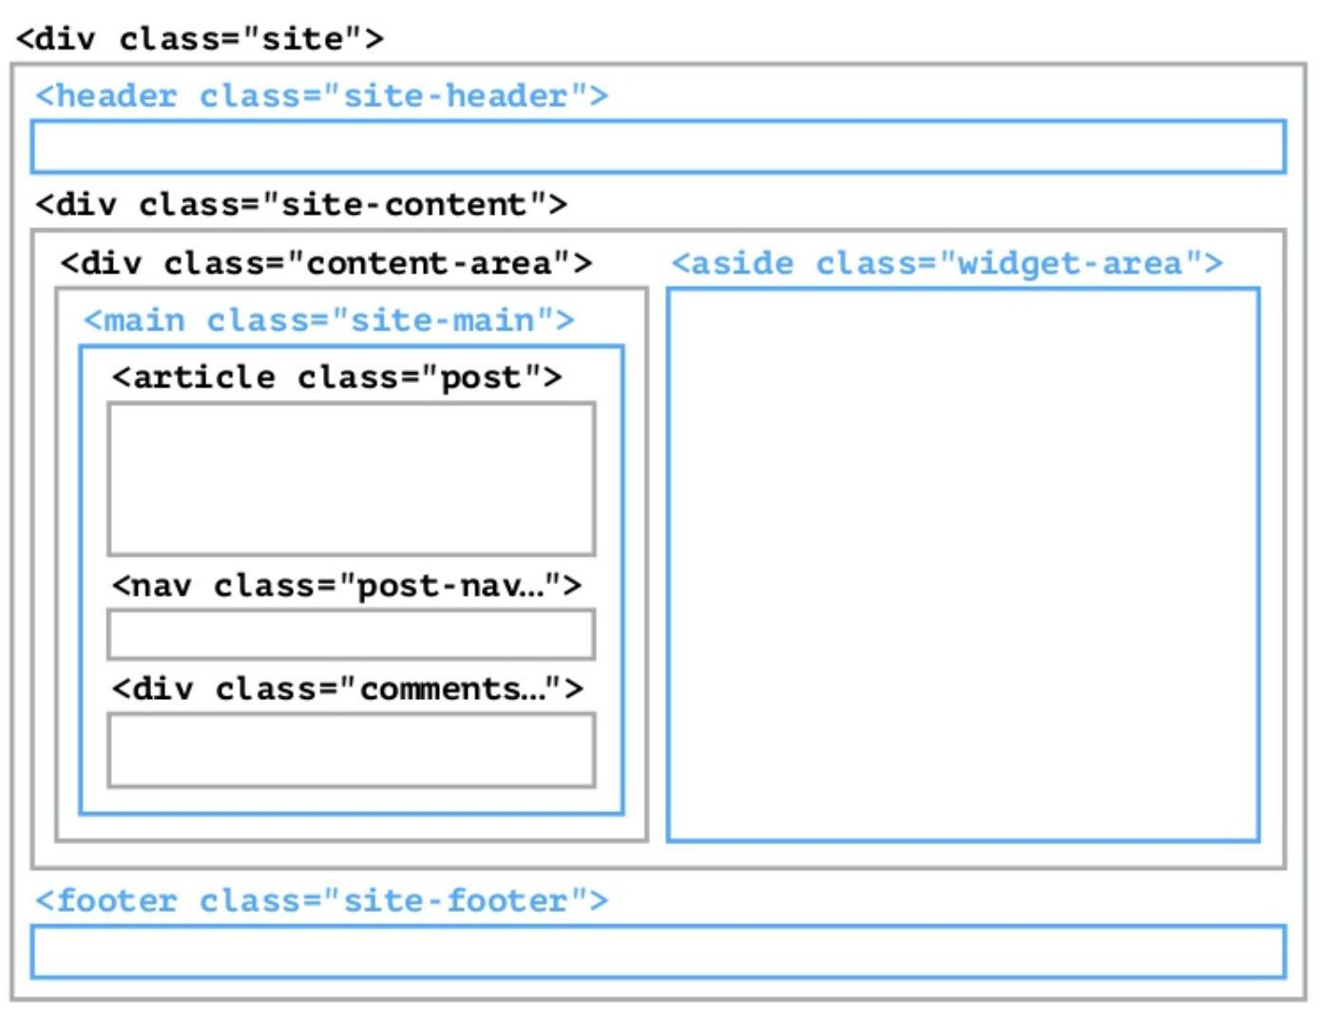
Advantages of CSS Grid
Layouting with CSS, real freedom to achieve any structure layout with CSS only, like it should be. (HTML div tag container is unnecessary with CSS grid)

Slide 3
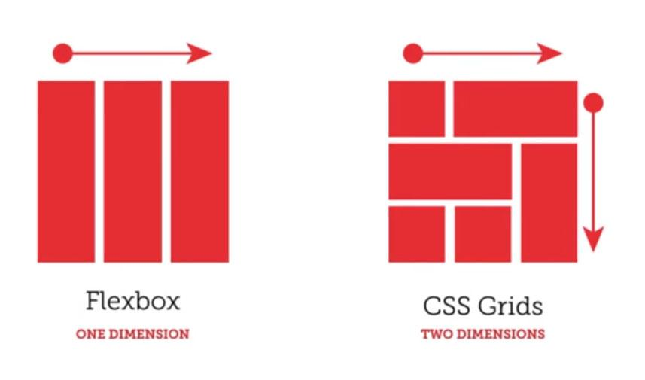
Advantages of CSS Grid
Has the advantages of flexbox, and can work in 2 dimension very easily.

Slide 4
Grid terminology

Slide 5
Grid Container
<div class=”site”>
<header class=”child”></header>
<main class=”child”></main>
<aside class=”child”>
<div class=”child-of-child”></div>
<!-- doesn’t effected-->
</aside>
<footer class=”child”></footer>
</div>
CSS
.site{
display:grid;
}

Slide 6
Grid Item
Any element that is a direct descendant of the grid.
<div class=”site”>
<header class=”child”></header>
<main class=”child”></main>
<aside class=”child”>
<div class=”child-of-child”></div>
<!-- doesn’t effected-->
</aside>
<footer class=”child”></footer>
</div>

Slide 7
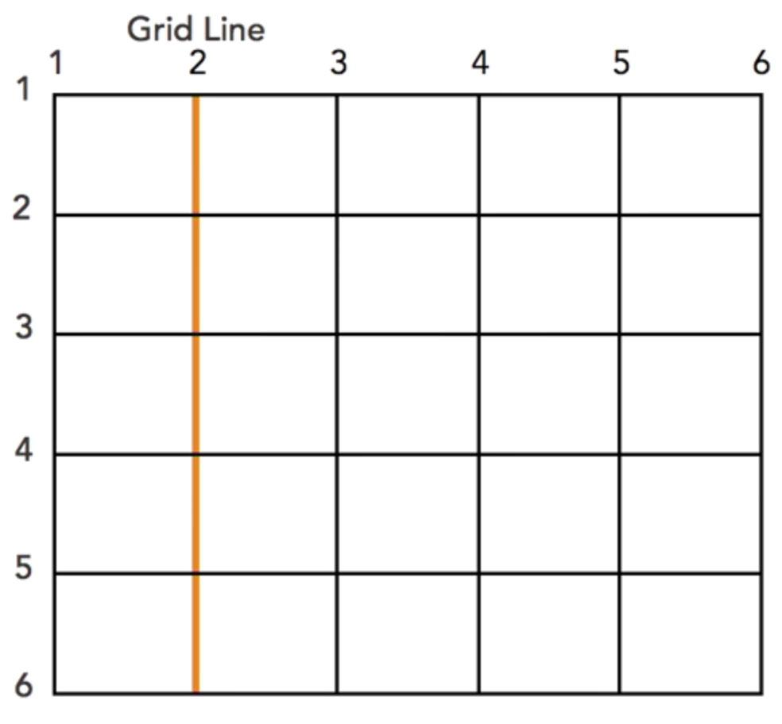
Grid Line
The horizontal and vertical lines that make up the grid.

Slide 8
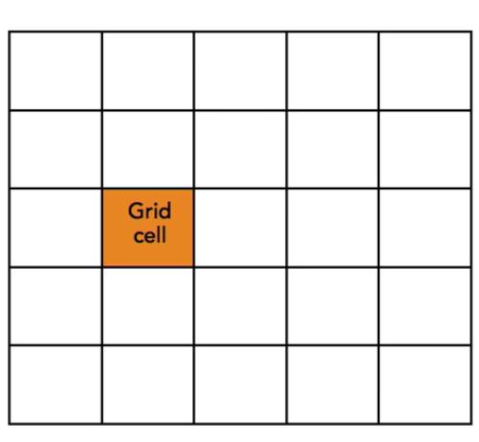
Grid Cell
The space between four grid lines

Slide 9
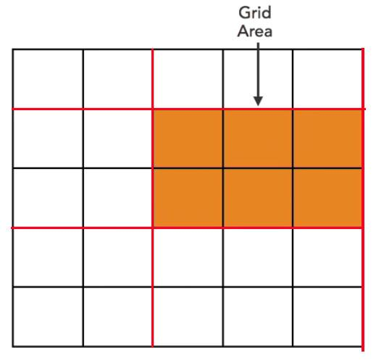
Grid Area
The area between four grid lines

Slide 10
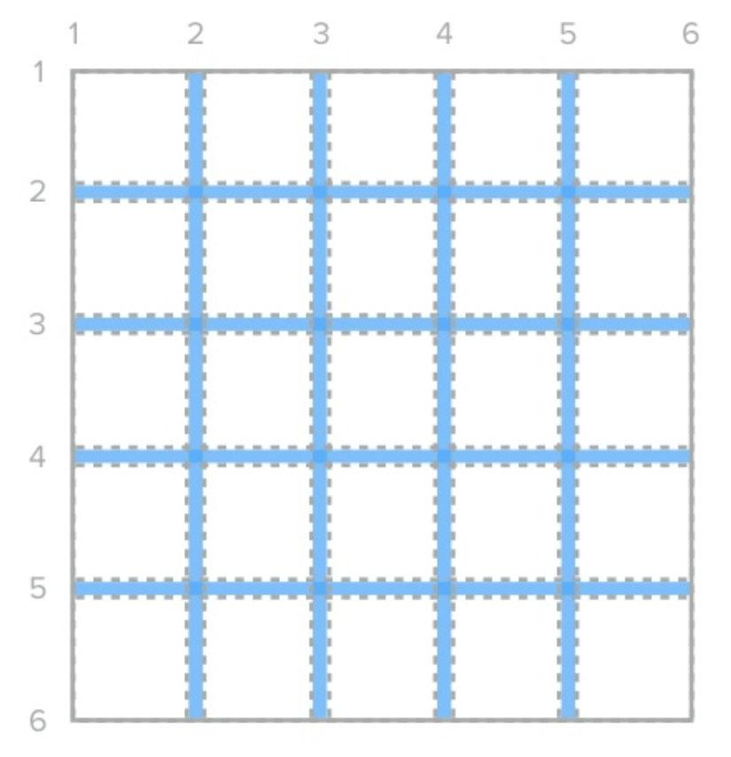
Grid Gap
Empty space between grid tracks
grid-column-gap:10px;
grid-row-gap:10px;
=
grid-gap:10px;

Slide 11
Grid Gap
Empty space between grid tracks
grid-column-gap:10px;
grid-row-gap:10px;
=
grid-gap:10px;

Slide 12
Let’s Start Gridding

Slide 13
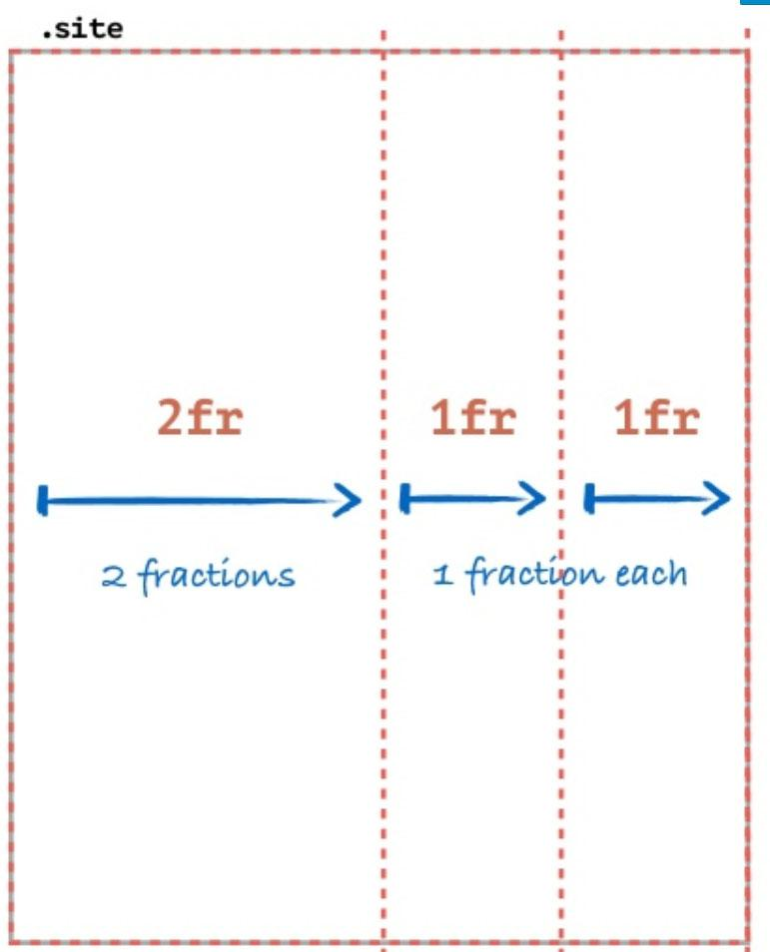
Grid-Template
.site{
display:grid;
grid-template-columns: 2fr 1fr 1fr;
}

Slide 14
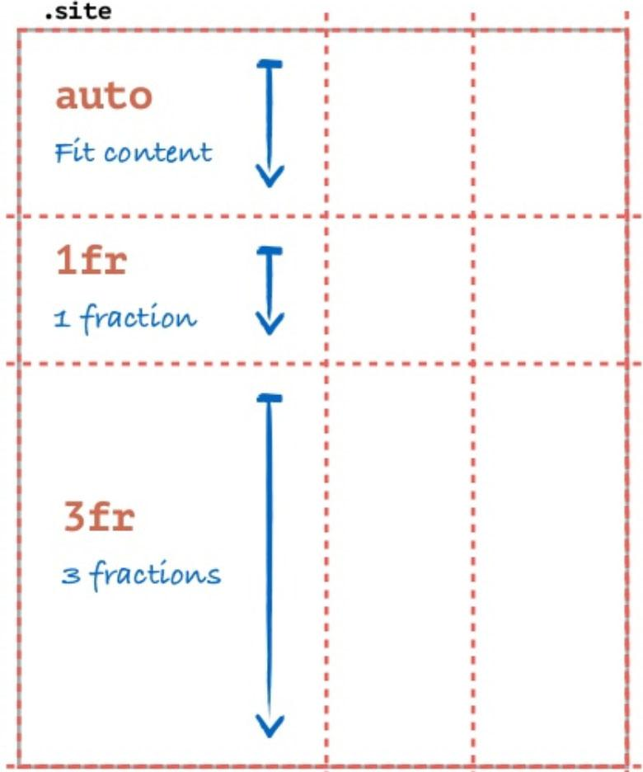
Grid-Template
.site{
Display:grid;
grid-template-columns: 2fr 1fr 1fr;
grid-template-rows: auto 1fr 3fr;
}

Slide 15
What is the fraction unit (fr) ?
The same as you have in flexbox flex: ‘integer’ ; is for proportion between cells or rows.

Slide 16
CSS Grid Methods

Slide 17
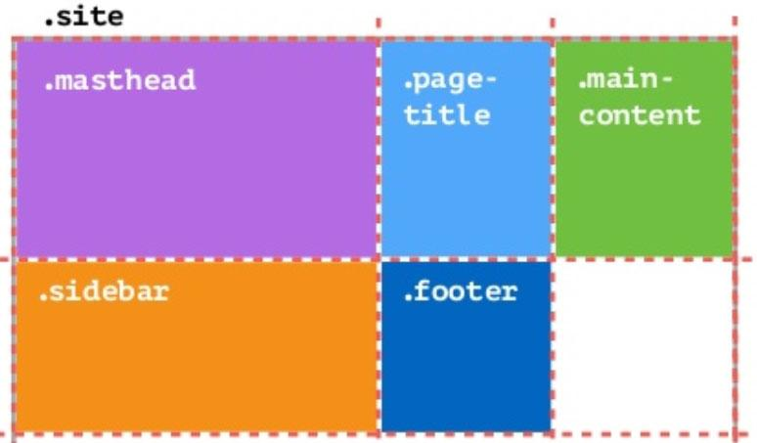
Base method
.site{
display:grid;
grid-template-columns: 2fr 1fr 1fr;
}
<div class=”site”>
<header class=”mastheader”></header>
<h1 class=”page-title”></h1>
<main class=”main-content”></main>
<aside class=”sidebar”></aside>
<footer class=”footer”></footer>
</div>
Example:
https://codepen.io/elad2412/pen/JrLeMG

Slide 18
Before we continue
Say hello to the
repeat function
grid-template-columns:1fr 1fr 1fr;
=
grid-template-columns:repeat(3 , 1fr);

Slide 19
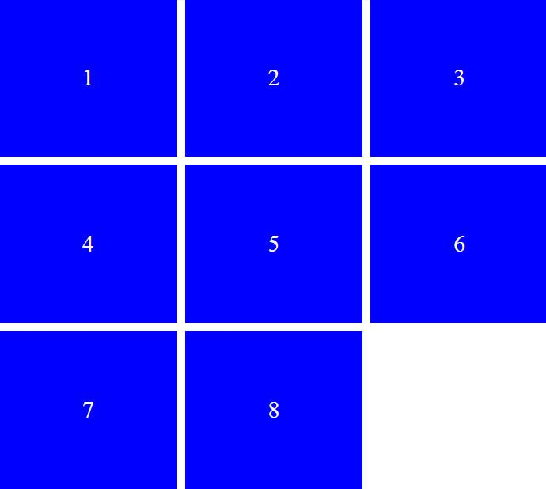
List Method
Using the “base method”and the “repeat function” we can easily achieve list sequence of items.
.site{
display:grid;
grid-template-columns: repeat(3, 1fr);
}
<ul class=”common-list”>
<li class=”common-list-item”>1</li>
<li class=”common-list-item”>2</li>
<li class=”common-list-item”>3</li>
…
</ul>
Example:
https://codepen.io/elad2412/pen/rGdomM

Slide 20
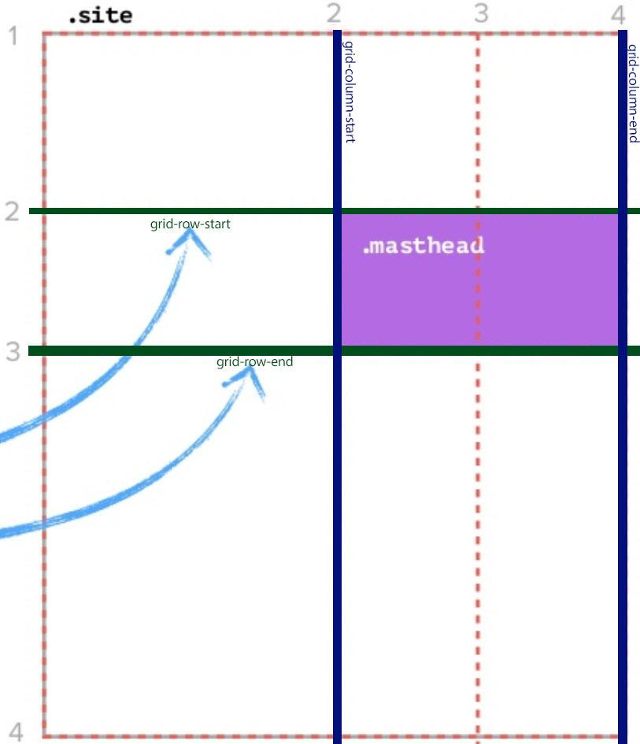
Positioning Method
Position grid item according the grid lines.
.site{
display:grid;
grid-template-columns: 2fr 1fr 1fr;
Grid-template-rows: auto 1fr 3fr;
}
.masthead{
grid-column:2/4;
grid-row:2/3;
}
same as:
.masthead{
grid-column-start:2;
grid-column-end:4;
grid-row-start:2;
grid-row-end:3;
}
Example:
https://codepen.io/elad2412/pen/mBxagg

Slide 21
Positioning Method
More syntax options
grid-row:2/3;
=
grid-row:2; /*will take one cell*/
grid-column:2/4;
=
grid-column:2/span 2; /*will take two cells;
Example:
https://codepen.io/elad2412/pen/mBxagg

Slide 22
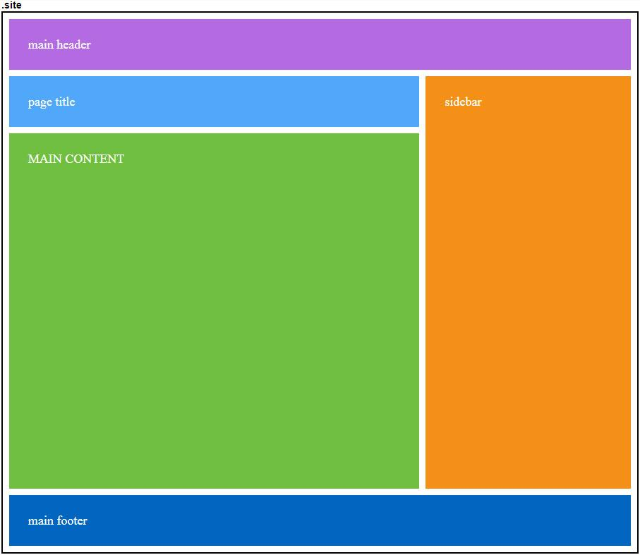
Areas Method
Positioning grid items according grid map.
<div class="site">
<header class="mastheader">main header</header>
<h1 class="page-title">page title</h1>
<main class="main-content">MAIN CONTENT</main>
<aside class="sidebar">sidebar</aside>
<footer class="footer">main footer</footer>
</div>
.site{
display:grid;
grid-template-columns:2fr 1fr; grid-gap:10px;
grid-template-areas:"header header"
"title sidebar"
"main sidebar"
"footer footer";
}
.mastheader{background:#b46ae3; grid-area:header;}
.page-title{background:#51a7fa; grid-area:title;}
.main-content{
background:#70bf40; grid-area:main; min-height:500px;
}
.sidebar{background:#f49018; grid-area:sidebar;}
.footer{background:#0265c0; grid-area:footer;}
Example: https://codepen.io/elad2412/pen/boMRaL

Slide 23
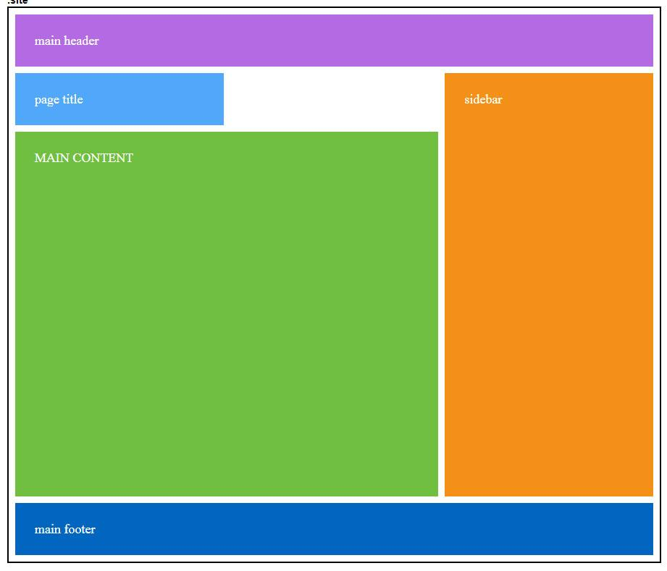
Areas Method
Saving EMPTY space with dot(.)
.site{
display:grid;
Grid-template-columns:1fr 1fr 1fr; grid-gap:10px;
grid-template-areas:"header header header"
"title . sidebar"
"main main sidebar"
"footer footer footer";
}
Example: https://codepen.io/elad2412/pen/GMdxrN

Slide 24
Finished the Basics

Slide 25
More Stuff to Know

Slide 26

Carousel with Grid ?
grid-auto-flow:column; without rows is the nowrap of grid.
.site{
display:grid;
grid-auto-flow:column;
}
<div class="site">
<div>1</div>
<div>2</div>
<div>3</div>
<div>4</div>
<div>5</div>
<div>6</div>
<div>7</div>
<div>8</div>
<div>9</div>
<div>10</div>
</div>
Example:
https://codepen.io/elad2412/pen/YrLErW

Slide 27
Grid Units
Beside the fr unit, you can use every unit, like pixels, percents.
grid-template-columns: 70% 30%;
=
grid-template-columns:7fr 3fr;
=
grid-template-columns:2.33fr 1fr;

Slide 28
Grid Units - Auto Unit
Auto unit - will take what lefts from the container.
grid-template-columns: 200px auto 200px;

Slide 29
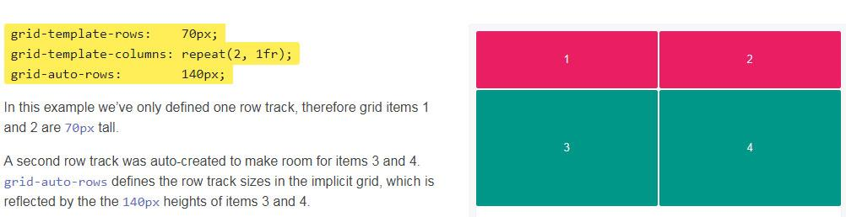
grid-auto-rows/columns & minmax function
When columns or rows aren't declared you can use this property to declare fix height/width to undeclared columns or rows, or use the new minmax function.

Slide 30
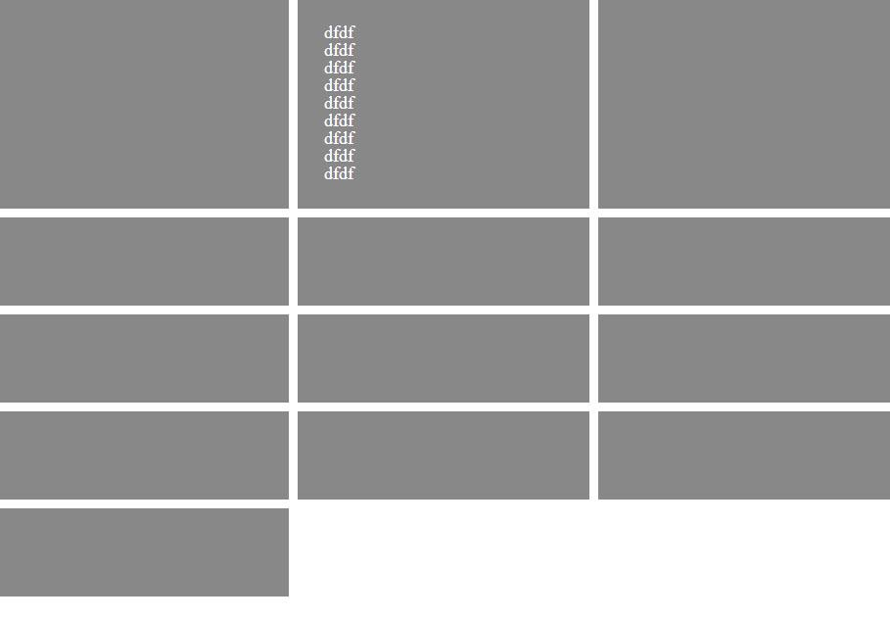
MinMax Function
.site{
display:grid; height:100%;
grid-template-columns:1fr 1fr 1fr;
grid-auto-rows:minmax(100px,auto);
grid-gap:10px;
}
Minimum height of 100px
Example:
https://codepen.io/elad2412/pen/MEGQBr

Slide 31
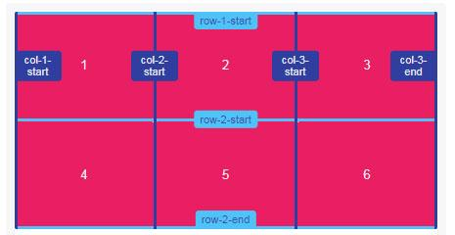
Naming Grid Lines
Grid lines can be named when defining the grid with the grid-template-rows and grid-template-columns properties. Line names can then be referenced to position grid items.
grid-template-rows: [row-1-start] 1fr [row-2-start] 1fr [row-2-end]; grid-template-columns: [col-1-start] 1fr [col-2-start] 1fr [col-3-start] 1fr [col-3-end];

Slide 32
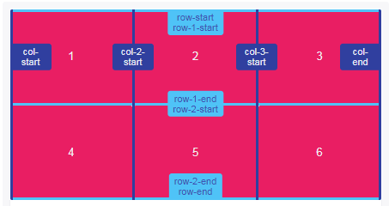
Naming Grid Lines - Multiple Names
Multiple names can be assigned to grid lines by adding names within square brackets and separating each with a whitespace.
Each line name can then be referenced when positioning grid items by line names.
grid-template-rows: [row-start row-1-start] 1fr [row-1-end row-2-start] 1fr [row-2-end row-end]; grid-template-columns: [col-start] 1fr [col-2-start] 1fr [col-3-start] 1fr [col-end];

Slide 33
Naming Grid Lines - Positioning Items by Line Names
grid-row: row-2-start / row-end; grid-column: col-2-start / col-end;

Slide 34
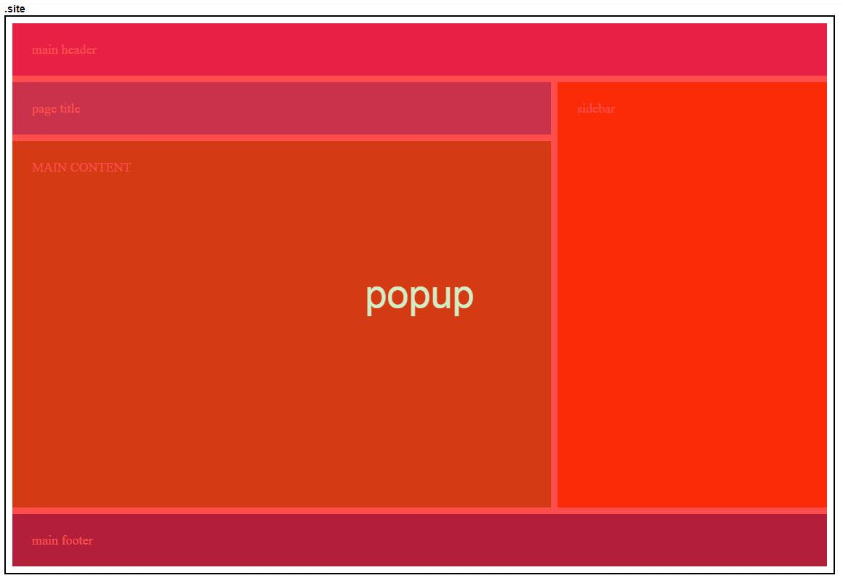
Overlapping Grid items
Grid items can be layered/stacked by properly positioning them and assigning z-index when necessary.
Example: https://codepen.io/elad2412/pen/yzjjyd

Slide 35
Finished?
Are you kidding me!

Slide 36
Remember flexbox aligning?
Justify-items, justify-self, align-items, align-self, justify-content, align-content….
All these rules are applying in CSS Grid and you can use them here.
You can learn them from my presentation of world of flexbox
https://www.slideshare.net/eladsc/world-of-flexbox
Or from this awesome website
http://learncssgrid.com/#aligning-grid-items
Order property of flexbox is working too.

Slide 37
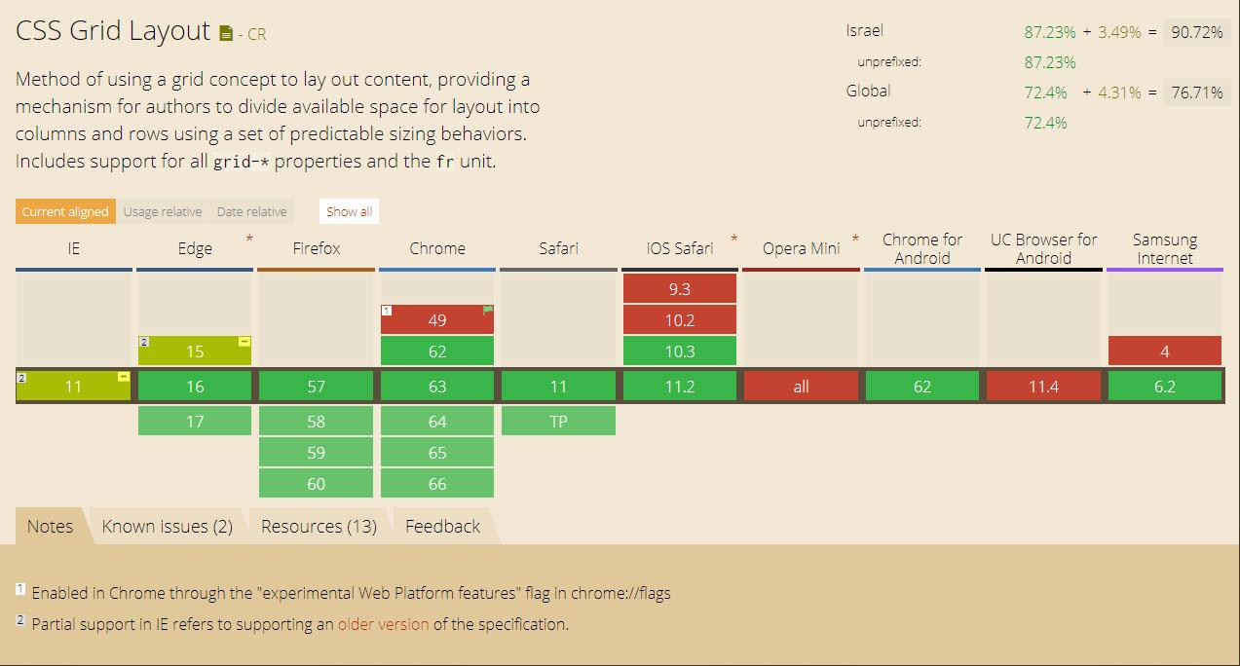
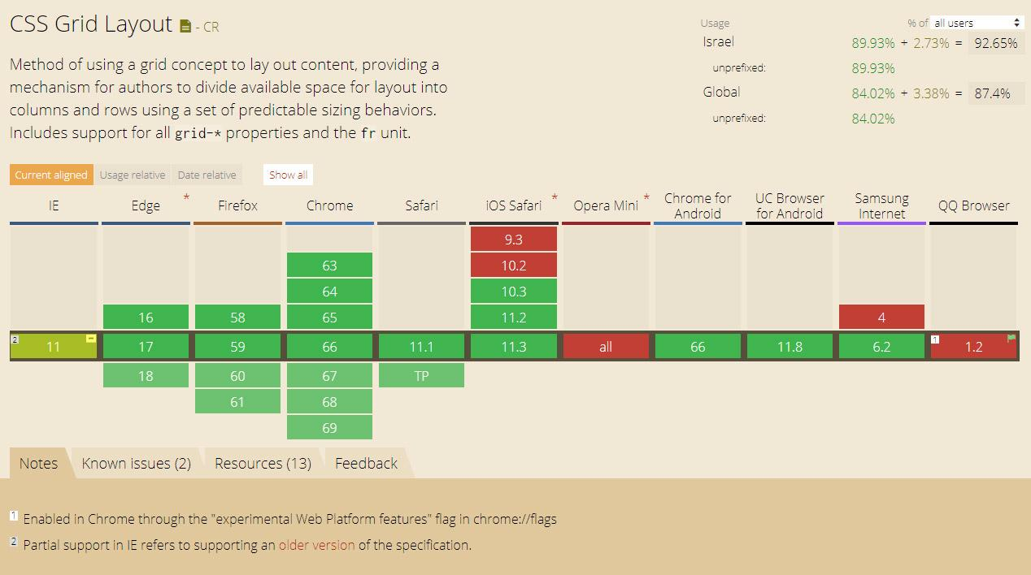
Support
Full support without prefix, almost in all browsers.
Old IE support it in the older version.
(14/1/2018):
(3/5/2018):

Slide 38
Using In Real Life
https://www.investing.com/crypto/ico-listing-request
https://www.allrates.com/loans/personal-loans
https://play.walla.co.il/

Slide 39
References
Videos:
CSS Grid Changes EVERYTHING - https://www.youtube.com/watch?v=7kVeCqQCxlk&index=1&list=PL8rji95IPUUCcHS8_JCAVDpuX4-fuNrtG
CSS Grid Layout Crash Course - https://www.youtube.com/watch?v=jV8B24rSN5o
CSS Grid terminology (Lynda.com) - https://www.lynda.com/CSS-tutorials/CSS-grid-terminology/422835/477279-4.html
Websites:
http://learncssgrid.com
https://css-tricks.com/snippets/css/complete-guide-grid/
https://developer.mozilla.org/en-US/docs/Web/CSS/grid-auto-columns
https://www.w3.org/TR/css-grid-1/

Slide 40
The End

